Slide 1
Programming with OpenGL Part 2: Complete Programs
Ed Angel
Professor of Emeritus of Computer Science
University of New Mexico

Slide 2
Objectives
Build a complete first program
Introduce shaders
Introduce a standard program structure
Simple viewing
Two-dimensional viewing as a special case of three-dimensional viewing
Initialization steps and program structure

Slide 3
Program Execution
WebGL runs within the browser
complex interaction among the operating system, the window system, the browser and your code (HTML and JS)
Simple model
Start with HTML file
files read in asynchronously
start with onload function
event driven input

Slide 4
Coordinate Systems
The units in points are determined by the application and are called object, world, model or problem coordinates
Viewing specifications usually are also in object coordinates
Eventually pixels will be produced in window coordinates
WebGL also uses some internal representations that usually are not visible to the application but are important in the shaders
Most important is clip coordinates

Slide 5
Coordinate Systems and Shaders
Vertex shader must output in clip coordinates
Input to fragment shader from rasterizer is in window coordinates
Application can provide vertex data in any coordinate system but shader must eventually produce gl_Position in clip coordinates
Simple example uses clip coordinates

Slide 6
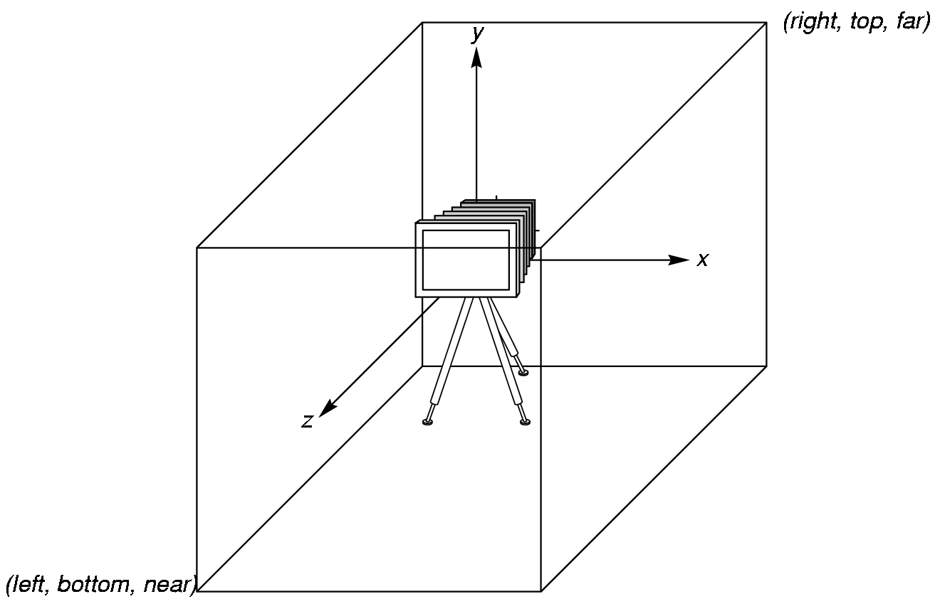
WebGL Camera
WebGL places a camera at the origin in object space pointing in the negative z direction
The default viewing volume
is a box centered at the
origin with sides of
length 2

Slide 7
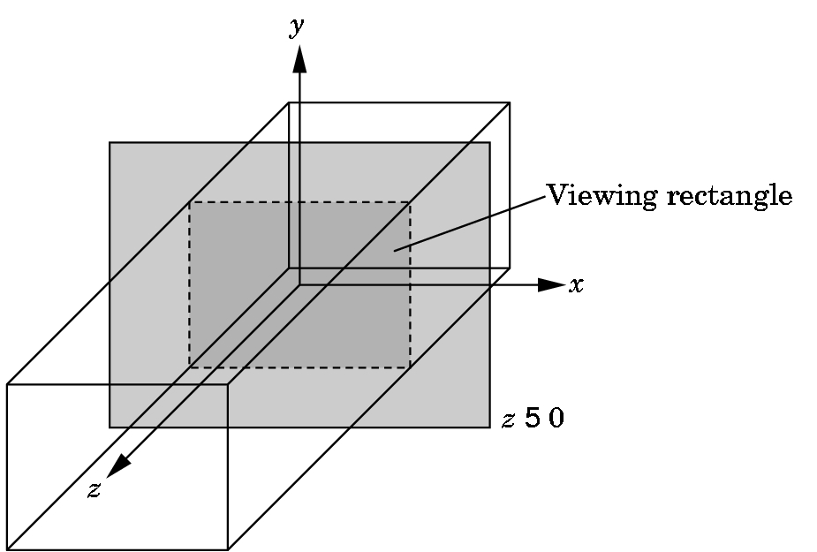
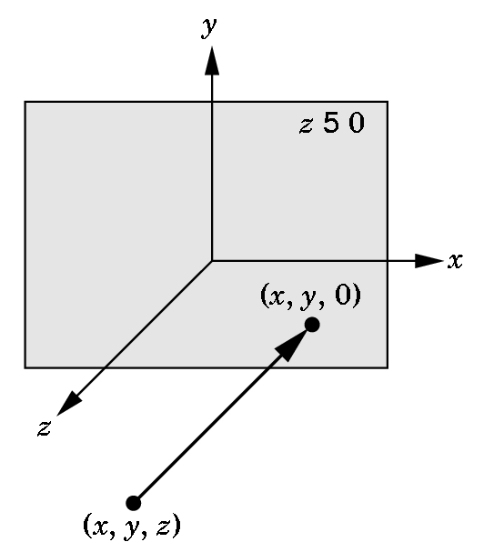
Orthographic Viewing
In the default orthographic view, points are
projected forward along the z axis onto the
plane z=0
z=0
z=0

Slide 8
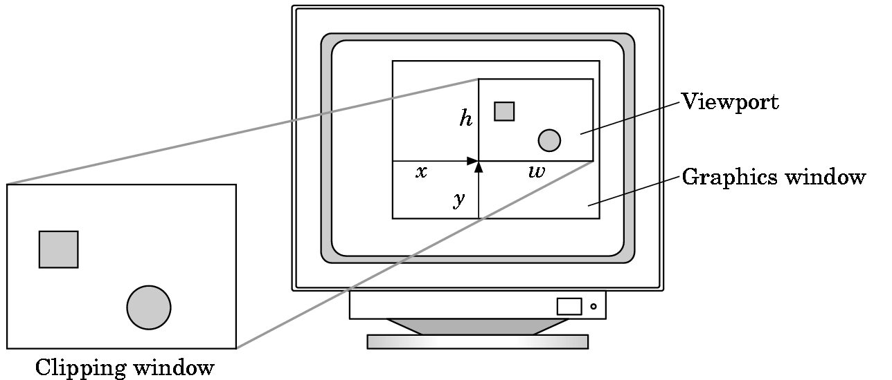
Viewports
Do not have use the entire window for the image: gl.viewport(x,y,w,h)
Values in pixels (window coordinates)

Slide 9
Transformations and Viewing
In WebGL, we usually carry out projection using a projection matrix (transformation) before rasterization
Transformation functions are also used for changes in coordinate systems
Pre 3.1 OpenGL had a set of transformation functions which have been deprecated
Three choices in WebGL
Application code
GLSL functions
MV.js

Slide 10
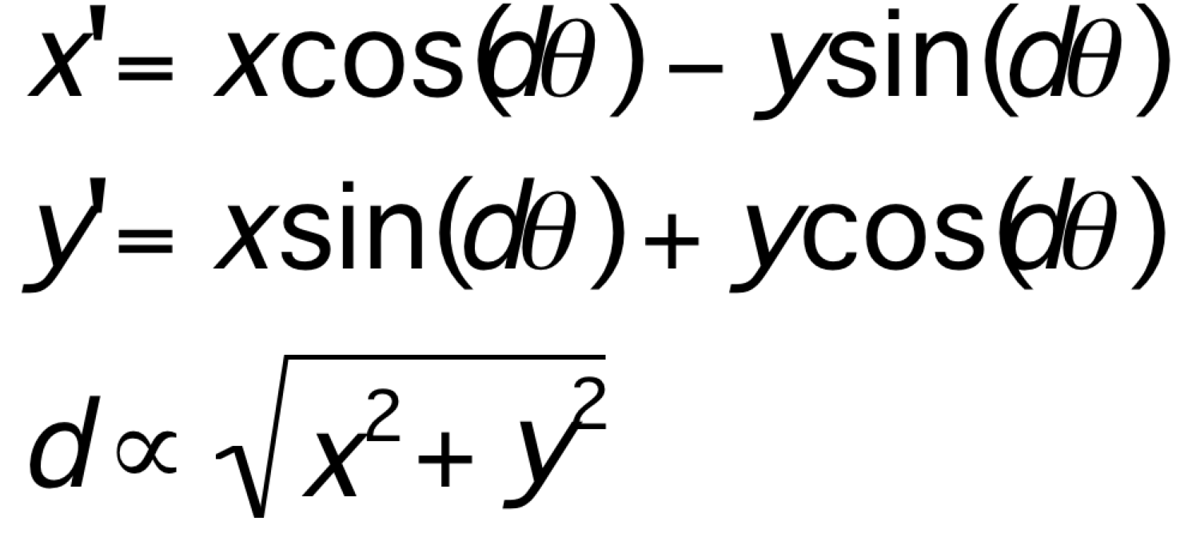
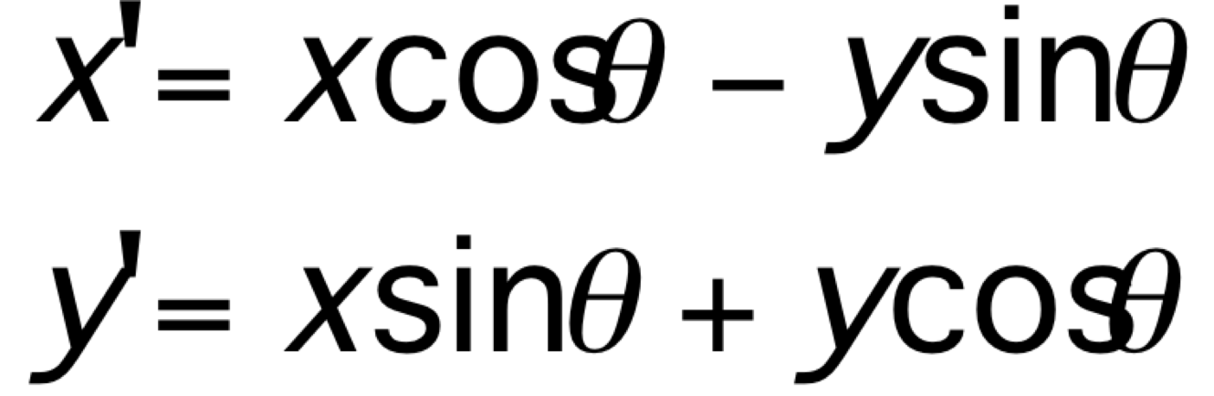
First Assignment: Tessellation and Twist
Consider rotating a 2D point about the origin
Now let amount of rotation depend on distance from origin giving us twist

Slide 11
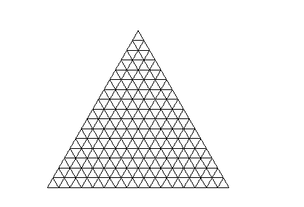
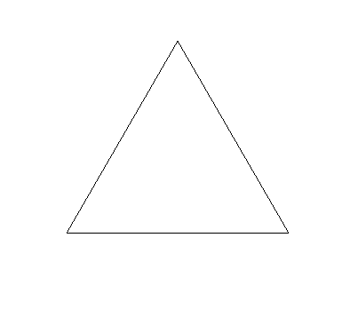


Example
triangle
tessellated triangle
twist without tessellation
twist after tessellation

Slide 12
Programming with WebGL Part 3: Shaders
Ed Angel
Professor of Emeritus of Computer Science
University of New Mexico

Slide 13
Objectives
Simple Shaders
Vertex shader
Fragment shaders
Programming shaders with GLSL
Finish first program

Slide 14
Vertex Shader Applications
Moving vertices
Morphing
Wave motion
Fractals
Lighting
More realistic models
Cartoon shaders

Slide 15
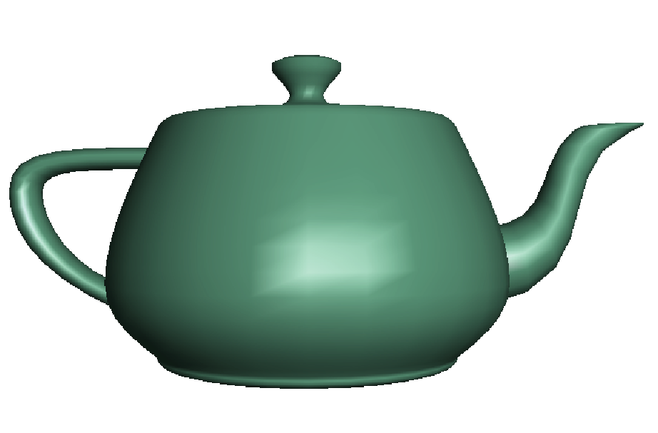
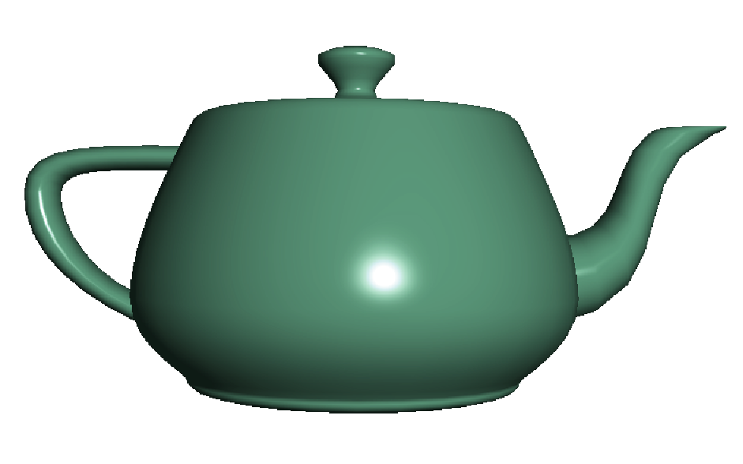
Fragment Shader Applications
Per fragment lighting calculations
per vertex lighting
per fragment lighting

Slide 16
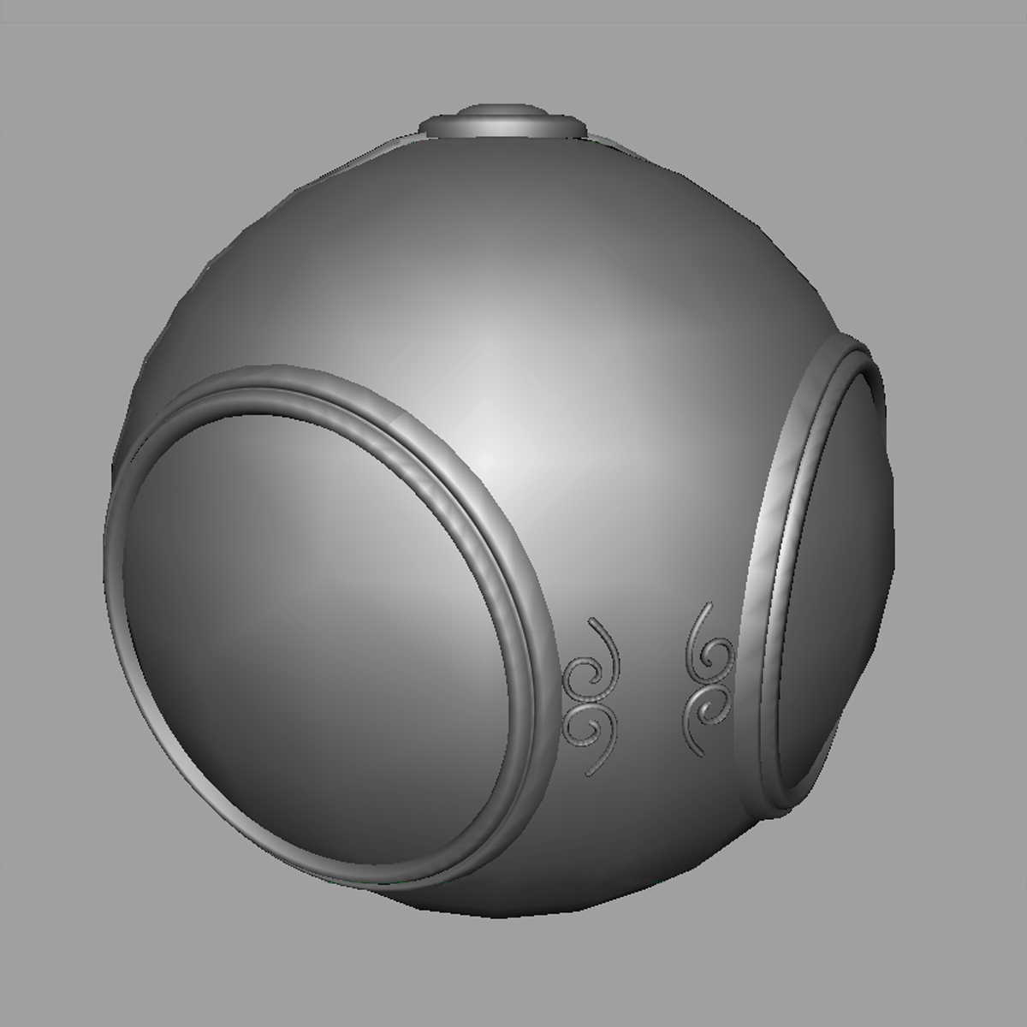

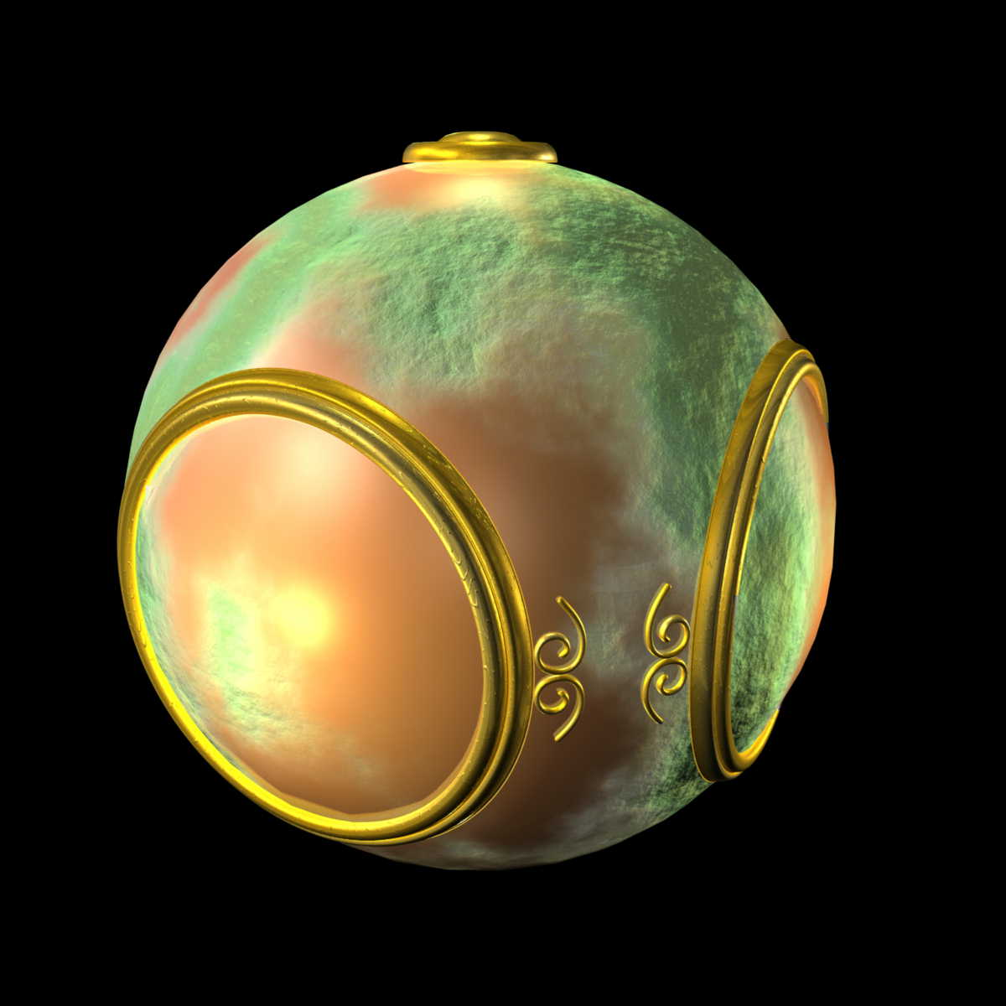
Fragment Shader Applications
Texture mapping
smooth shading
environment
mapping
bump mapping

Slide 17
Writing Shaders
First programmable shaders were programmed in an assembly-like manner
OpenGL extensions added functions for vertex and fragment shaders
Cg (C for graphics) C-like language for programming shaders
Works with both OpenGL and DirectX
Interface to OpenGL complex
OpenGL Shading Language (GLSL)

Slide 18
GLSL
OpenGL Shading Language
Part of OpenGL 2.0 and up
High level C-like language
New data types
Matrices
Vectors
Samplers
As of OpenGL 3.1, application must provide shaders

Slide 19
Simple Vertex Shader
attribute vec4 vPosition;
void main(void)
{
gl_Position = vPosition;
}
input from application
must link to variable in application
built in variable

Slide 20
Execution Model
Vertex data
Shader Program
GPU
Application
Program
Vertex
Shader
Primitive
Assembly
gl.drawArrays
Vertex

Slide 21
Simple Fragment Program
precision mediump float;
void main(void)
{
gl_FragColor = vec4(1.0, 0.0, 0.0, 1.0);
}

Slide 22
Execution Model
Application
Shader Program
Rasterizer
Fragment
Shader
Frame Buffer
Fragment
Fragment
Color

Slide 23
Data Types
C types: int, float, bool
Vectors:
float vec2, vec3, vec4
Also int (ivec) and boolean (bvec)
Matrices: mat2, mat3, mat4
Stored by columns (“column-major”. floats
Standard referencing m[row][column]
C++ style constructors (no use of “new”)
vec3 a =vec3(1.0, 2.0, 3.0)
vec2 b = vec2(a)

Slide 24
No Pointers
There are no pointers in GLSL
We can use C structs which
can be copied back from functions
Because matrices and vectors are basic types they can be passed into and output from GLSL functions, e.g.
mat3 func(mat3 a)
variables passed by copying

Slide 25
Qualifiers
GLSL has many of the same qualifiers such as const as C/C++
Need others due to the nature of the execution model
Variables can change
Once per primitive
Once per vertex
Once per fragment
At any time in the application
Vertex attributes are interpolated by the rasterizer into fragment attributes

Slide 26
Attribute Qualifier
Attribute-qualified variables can change at most once per vertex
There are a few built in variables such as gl_Position but most have been deprecated
User defined (in application program)
attribute float temperature
attribute vec3 velocity
recent versions of GLSL use in and out qualifiers to get to and from shaders
Use in qualifier to get to shader

Slide 27
Uniform Qualified
Variables that are constant for an entire primitive
Can be changed in application and sent to shaders
Cannot be changed in shader
Used to pass information to shader such as the time or a bounding box of a primitive or transformation matrices

Slide 28
Varying Qualified
Variables that are passed from vertex shader to fragment shader
Automatically interpolated by the rasterizer
With WebGL, GLSL uses the varying qualifier in both shaders
varying vec4 color;
More recent versions of WebGL use out in vertex shader and in in the fragment shader
out vec4 color; //vertex shader
in vec4 color; // fragment shader

Slide 29
Author’s Naming Convention
attributes passed to vertex shader have names beginning with v (vPosition, vColor) in both the application and the shader
Note that these are different entities with the same name
Varying variables begin with f (fColor) in both shaders
must have same name
Uniform variables are unadorned and can have the same name in application and shaders

Slide 30
Example: Vertex Shader
const vec4 red = vec4(1.0, 0.0, 0.0, 1.0);
out vec3 color_out;
void main(void)
{
gl_Position = vPosition;
color_out = red;
}
Notes:
Because color_out is out it must be defined as in in the corresponding fragment shader (next page)

Slide 31
Corresponding Fragment Shader
precision mediump float;
varying vec3 fColor;
void main()
{
gl_FragColor = fColor;
}

Slide 32
Sending Colors from Application
var cBuffer = gl.createBuffer();
gl.bindBuffer( gl.ARRAY_BUFFER, cBuffer );
gl.bufferData( gl.ARRAY_BUFFER, flatten(colors),
gl.STATIC_DRAW );
var vColor = gl.getAttribLocation( program, "vColor" );
gl.vertexAttribPointer( vColor, 3, gl.FLOAT, false, 0, 0 );
gl.enableVertexAttribArray( vColor );

Slide 33
Sending a Uniform Variable
// in application
vec4 color = vec4(1.0, 0.0, 0.0, 1.0);
colorLoc = gl.getUniformLocation( program, ”color" );
gl.uniform4f( colorLoc, color);
// in fragment shader (similar in vertex shader)
uniform vec4 color;
void main()
{
gl_FragColor = color;
}

Slide 34
Operators and Functions
Standard C functions
Trigonometric
Arithmetic
Normalize, reflect, length
Overloading of vector and matrix types
mat4 a;
vec4 b, c, d;
c = b*a; // a column vector stored as a 1d array
d = a*b; // a row vector stored as a 1d array

Slide 35
Swizzling and Selection
Can refer to array elements by element using [] or selection (.) operator with
x, y, z, w
r, g, b, a
s, t, p, q
a[2], a.b, a.z, a.p are the same
Swizzling operator lets us manipulate components
vec4 a, b;
a.yz = vec2(1.0, 2.0, 3.0, 4.0);
b = a.yxzw;

